Slide 1
Building the Donor Pipeline: Donor Relations from the Ground Up
Presenter: Leslie Carmona, CFRE Director of Donor Relations Wayne State University

Slide 2
A little about me…
Native Detroiter
Animal lover
Michigan wine fan
And lover of all things fundraising!
Notes:
Held different roles, worked in many aspects of fundraising over the years.

Slide 3
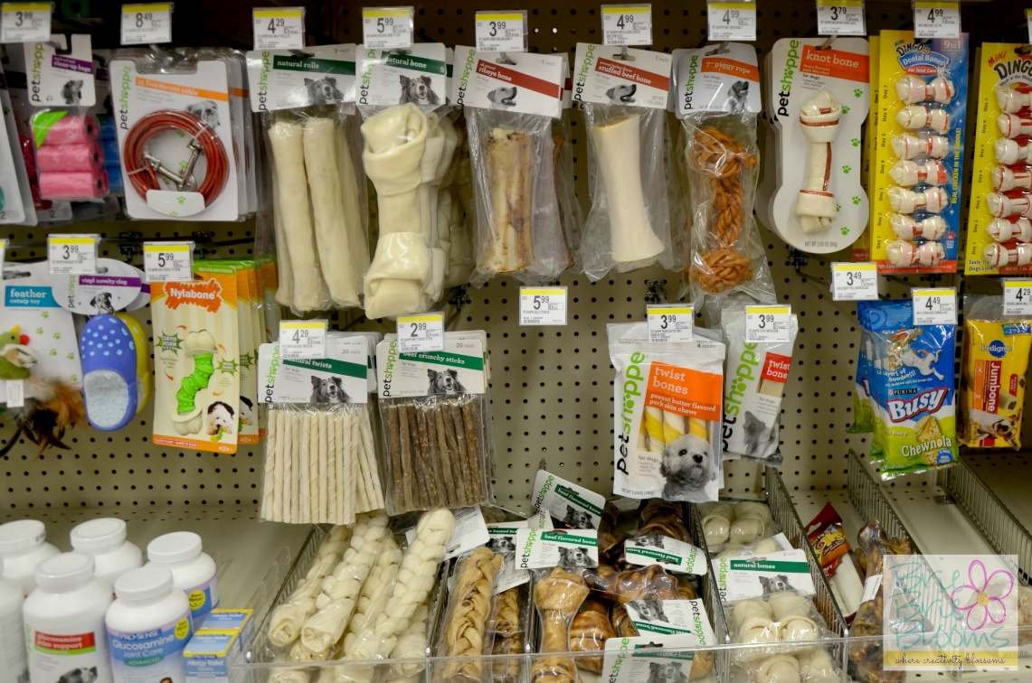
So you took on the job!

Slide 4
And it feels like there is a whole world of work to tackle!
Notes:
In the following slides I’m going to tell you how I went about tackling the big project of creating a Donor Relations program at Wayne State. But to understand the full picture, let me first tell you a little bit about Wayne State!

Slide 5
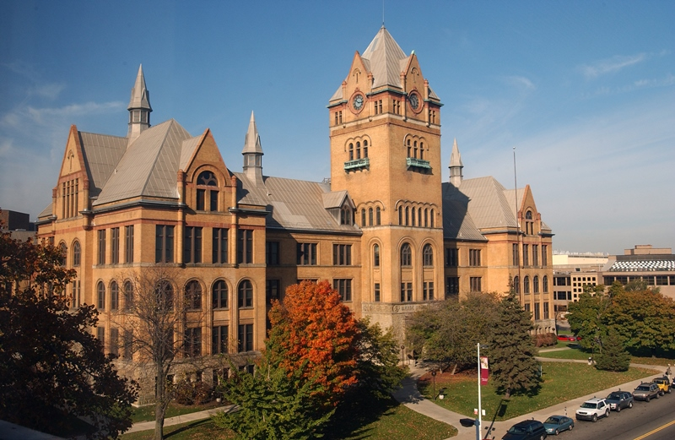
Wayne State University
150 years
Top-tier research university
Urban setting
$750M Campaign
Young Development Program
And…until 2015…NO
Donor Relations Department
Notes:
Talk about the top heavy nature of WSU Development program

Slide 6
The development structure looked a bit like this…
Notes:
How to build the DONOR PIPELINE!!

Slide 7
Where do you even start?
Make a list, take some deep breaths and start at the beginning!
Focus on the 4 Pillars (Lynne Wester):
Stewardship and Impact Reporting
Acknowledgement
Recognition
Engagement
Ask yourself:
What part of your donor population is most at risk?
For WSU:
First time donors, recent grads, donors under $300
Notes:
Identify and stop the hemorrhaging!!

Slide 8
First Time Givers (FTG) Program
Within 72 hours—School/College specific TY
Within 30 days—FTG postcard
Within 60 days—Thank you phone all
10-11 months—Anniversary TY
Duel signatures
15 months—Targeted appeal
18 months—Added to call center list
Notes:
Why do you think I decided to start here?

Slide 9
First Time Givers (FTG) Program
Notes:
Talk here about retention rate…that’s why this was the first step

Slide 10
First Time Givers (FTG) Program

Slide 11
Acknowledgements
BFDR (Before Donor Relations)
Decentralized
4-5 week average turnaround
Differing levels
Missing roughly 72% or donors
Data issues

Slide 12
Acknowledgements
Notes:
Create something that an alumni would want to put on their wall!

Slide 13
Acknowledgements

Slide 14
Acknowledgements
Centralized program
3rd party vendor
Postcards
72 hour turn around
Continuously improved
Multiple touch points for donors at different levels of giving
Specialized/Custom letters from VP of Development and President
Notes:
What it looks like now….

Slide 15
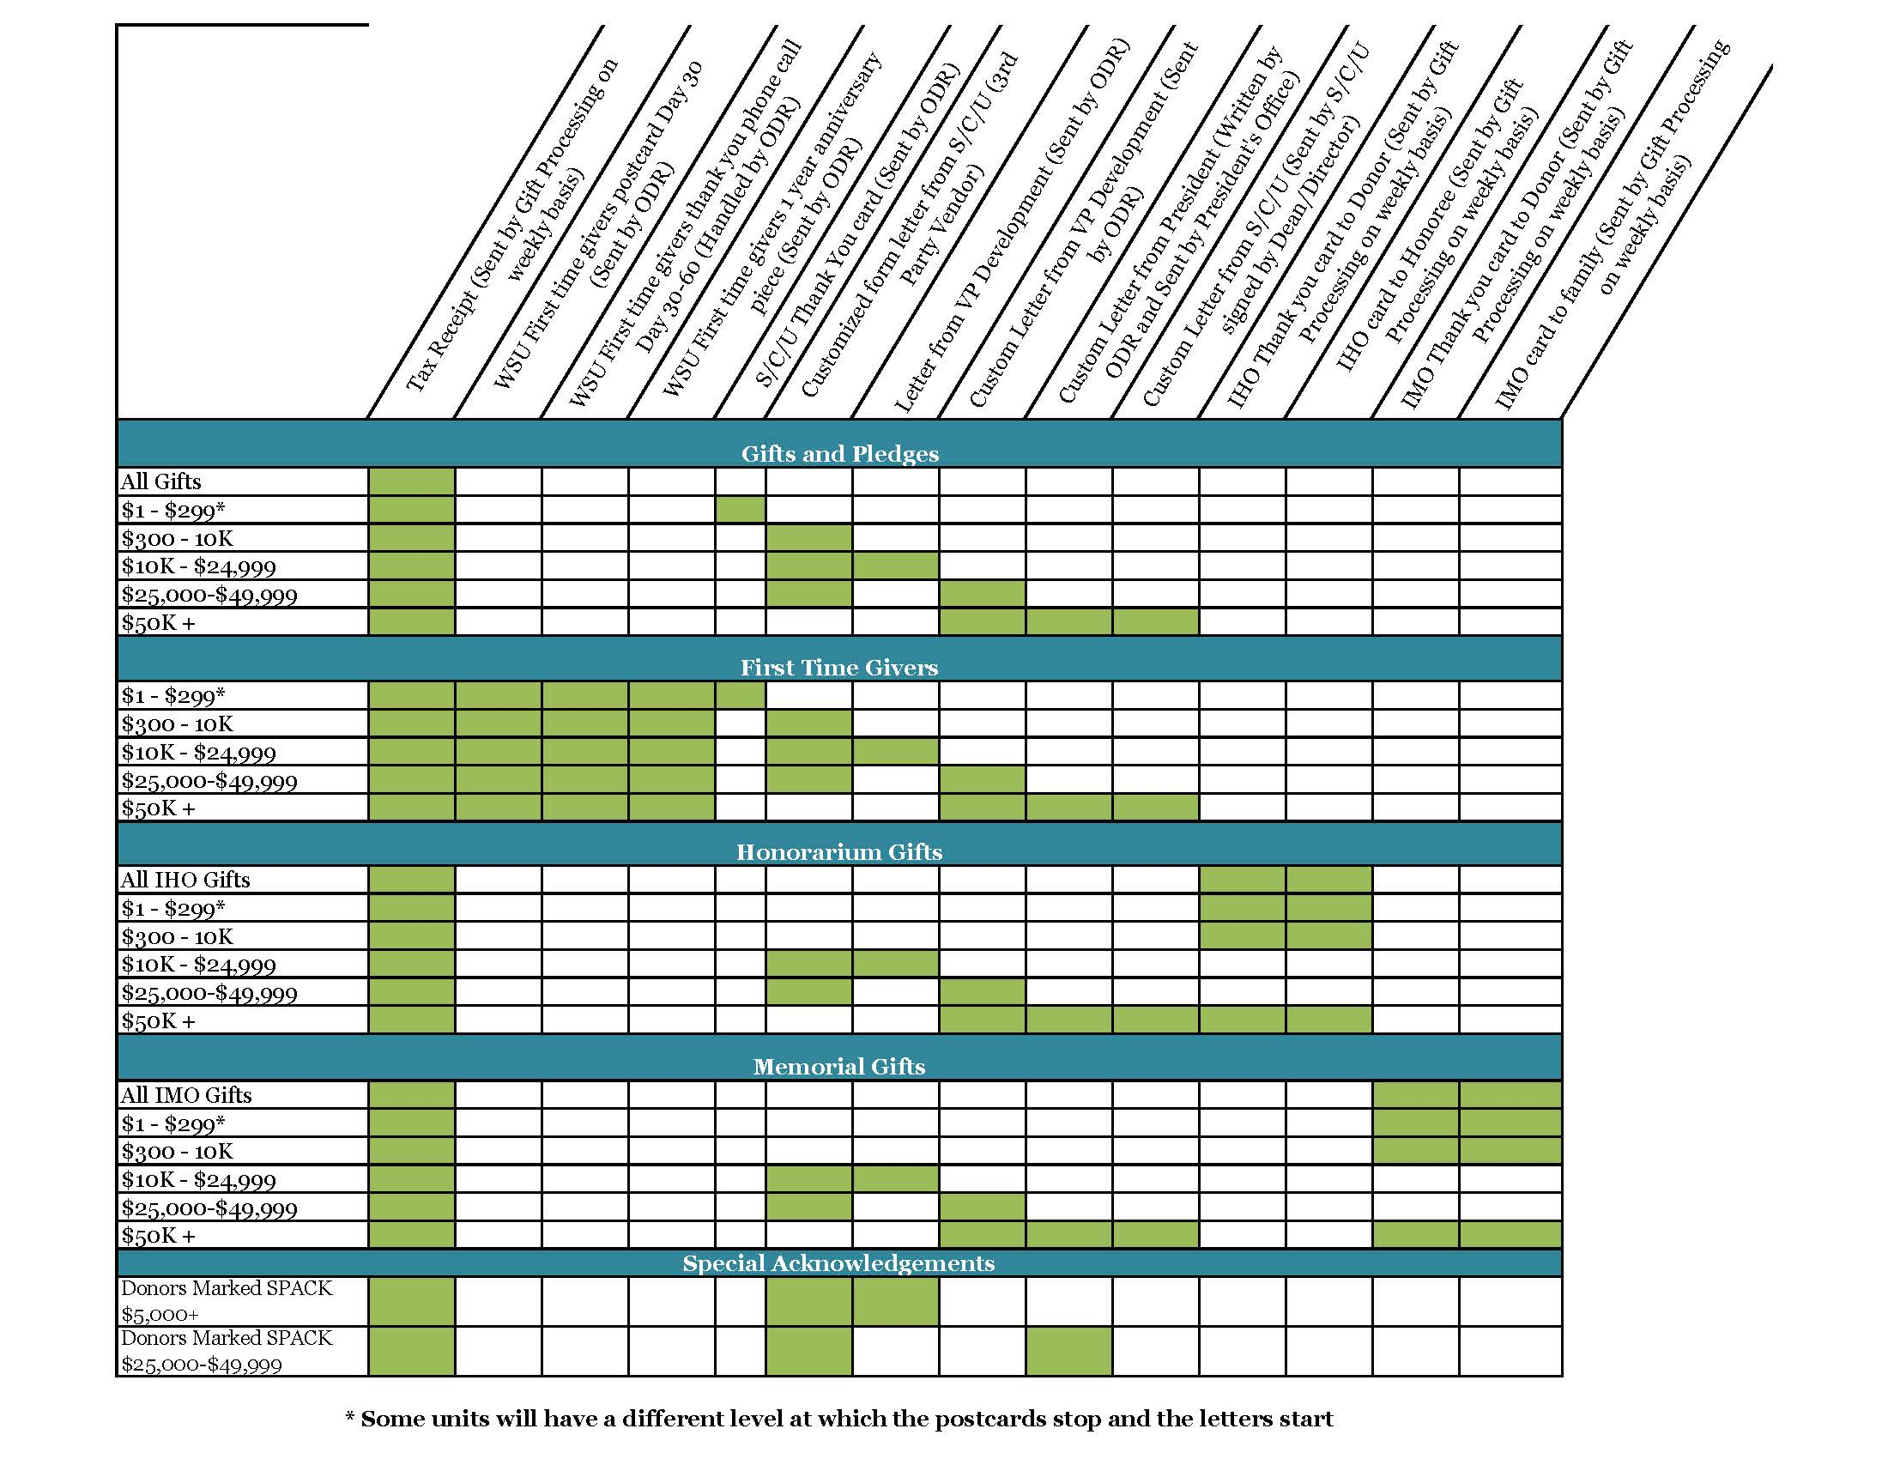
Notes:
What it looks like now….

Slide 16
Look at the complete Donor Life Cycle
Notes:
Look at the complete cycle of giving at your institution.
How will you steward and engage donors at all of these levels?
Key to building a donor pipeline

Slide 17
Stewardship Plans and Planning
Stewarded through:
You’re only a FTG once!
FTG Program
Built in touches

Slide 18
Stewardship Plans and Planning
Stewarded through:
Wayne Loyal
Consecutive Donor Society
Consecutive Donor Travel Strategy
Faculty/Staff Campaign
Notes:
WSU was not in the place to celebrate levels of giving.

Slide 19
Stewardship Plans and Planning
Stewarded through:
Wayne Loyal
No formal Leadership Annual Giving program yet at Wayne State
Eventually: Custom stewardship plans for top 10%
Notes:
This is still an area that we need to work on. We thought we would be able to do more here.

Slide 20
Stewardship Plans and Planning
Stewarded through:
Anthony Wayne Society
Moving away from “Black Tie”
One large impact/recognition event yearly
Small intimate/exclusive opportunities during the year (hard hat tours, grand openings etc.)
FY18—adding small intimate dinners for donors of $100K+ with key university staff
Custom stewardship plans for top 10%
Notes:
Anthony Wayne Society Changes!!!!!

Slide 21
Stewardship Plans and Planning
Stewarded through:
Old Main Society
Small intimate/exclusive opportunities during the year (hard hat tours, grand openings etc.)
Special impact reports for Planned Giving Donors
Custom stewardship plans for top 10%
Notes:
Talk about the new girl mistake with the Old Main Society
Planned Giving Impact Reports

Slide 22
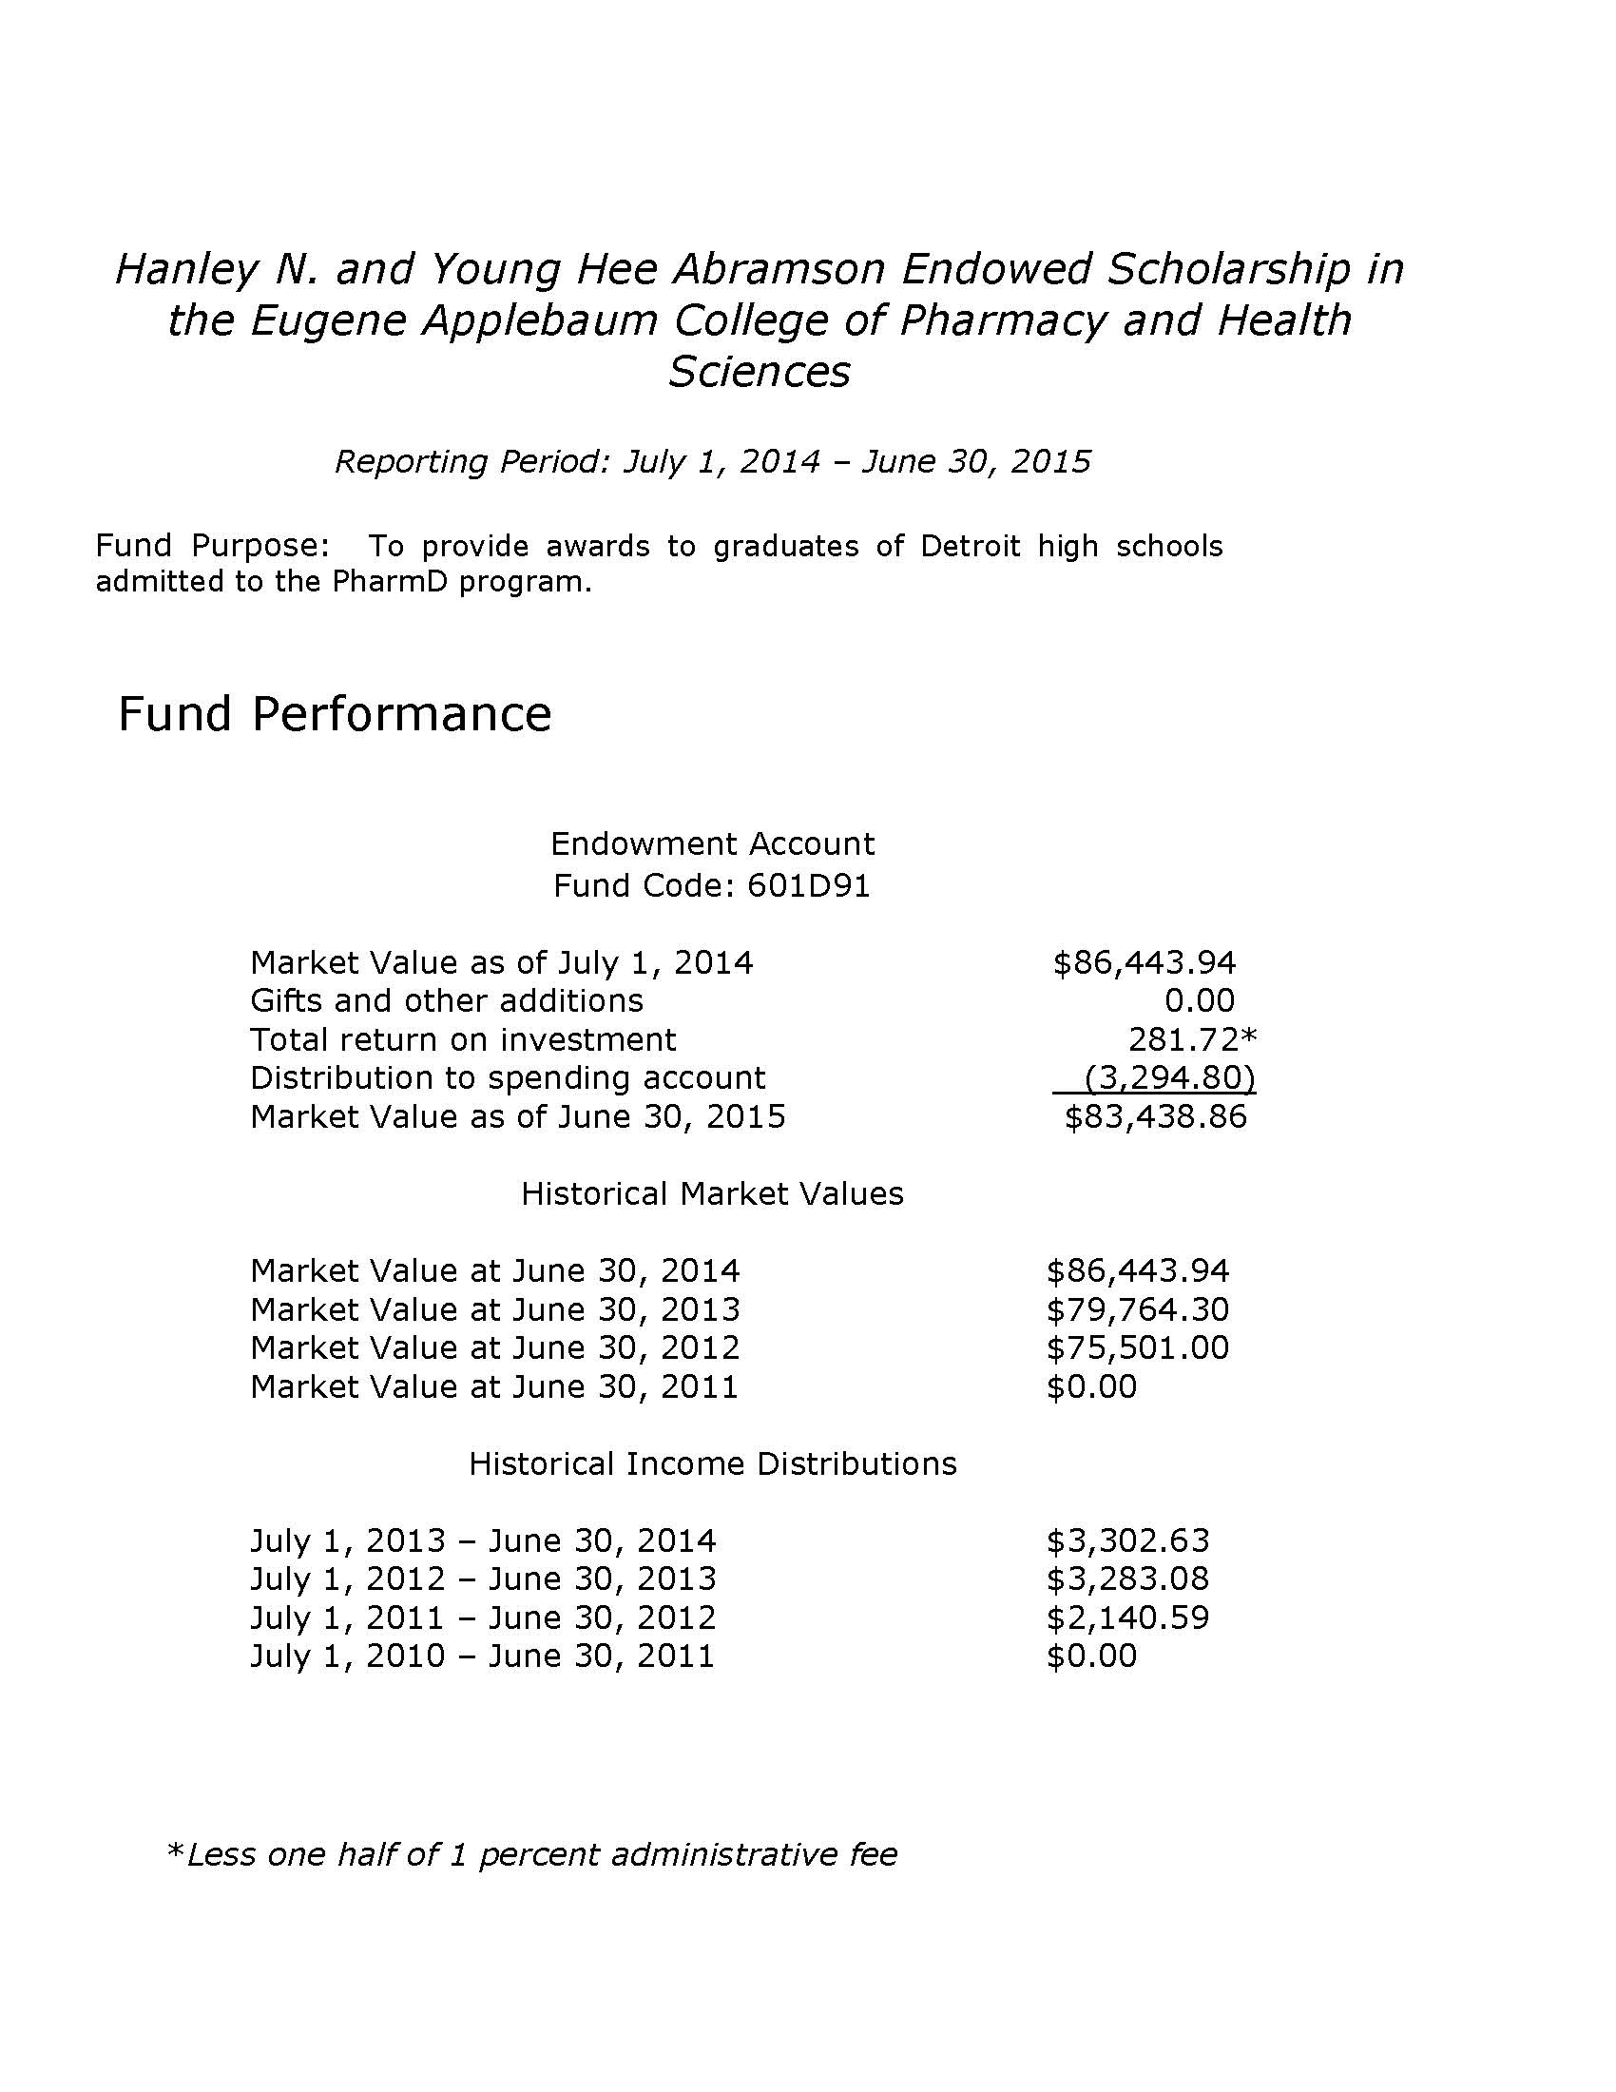
Impact Reporting
Change of vernacular
Simplify!
Financial report vs. stewardship report
Develop a system
Endowed and Annual
Planned Giving!

Slide 26
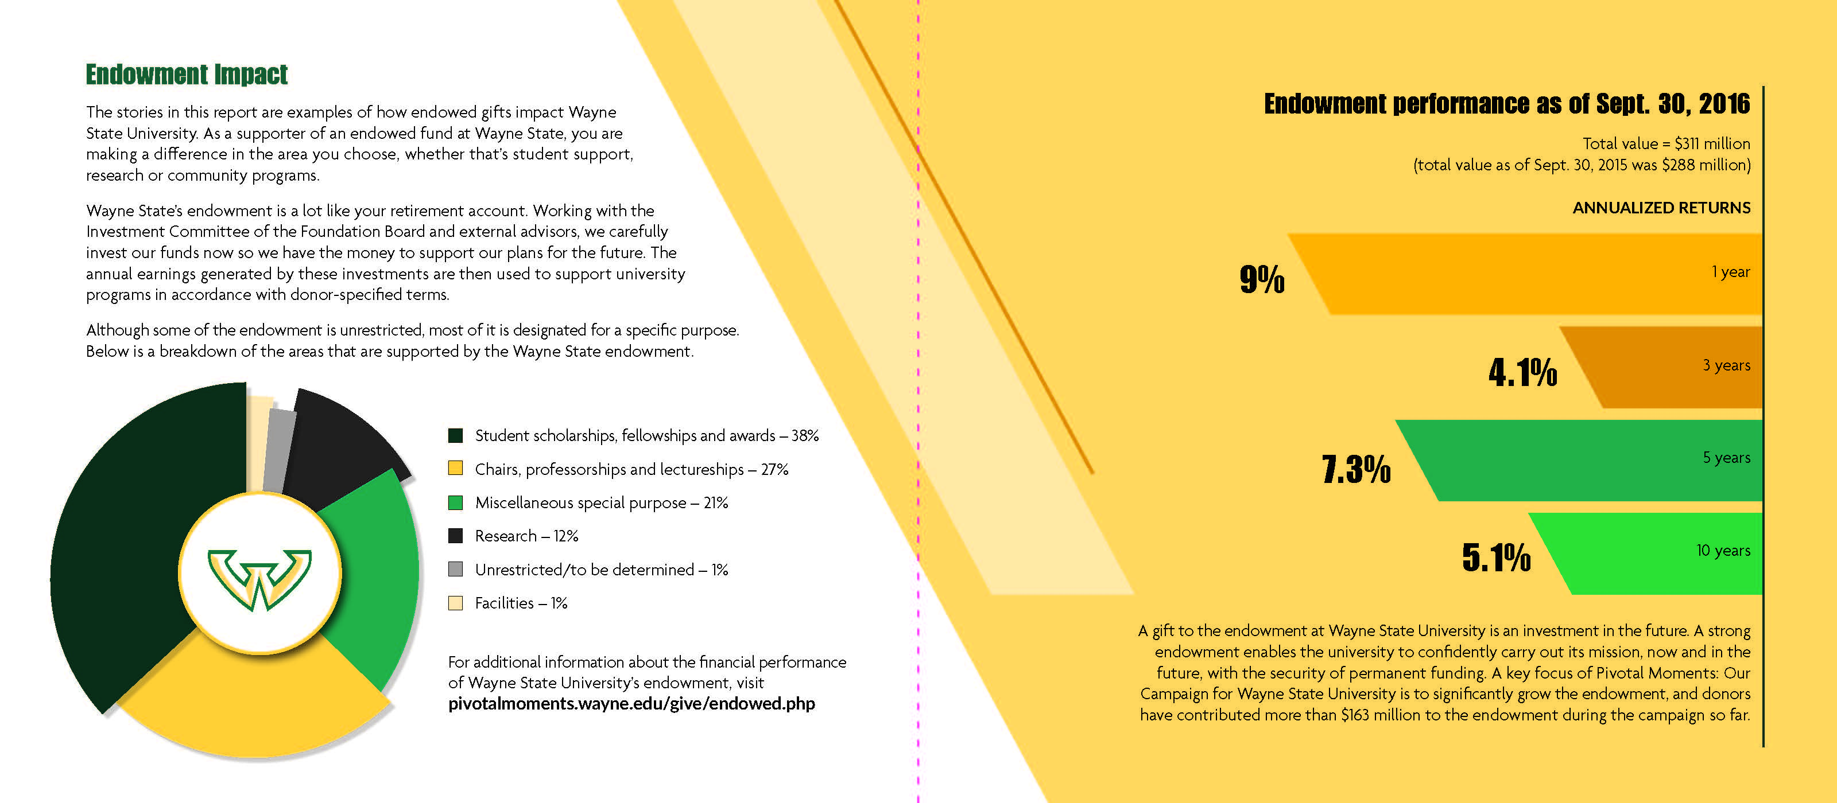

Slide 27
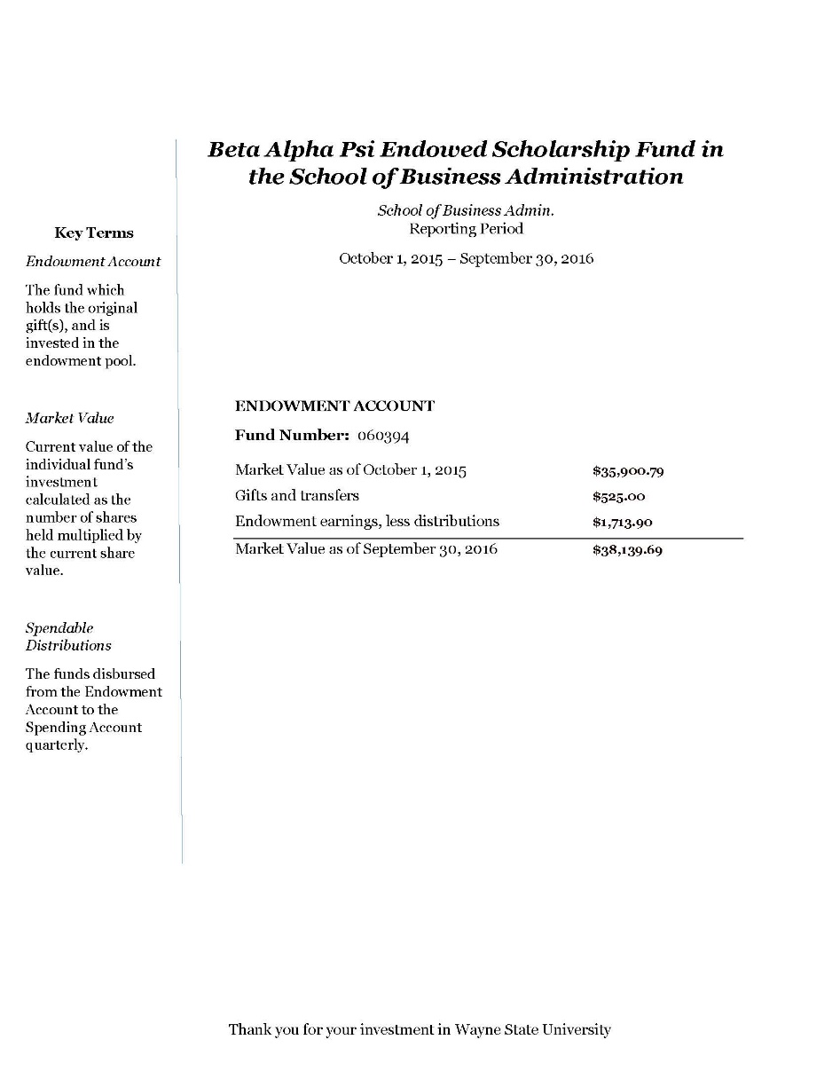
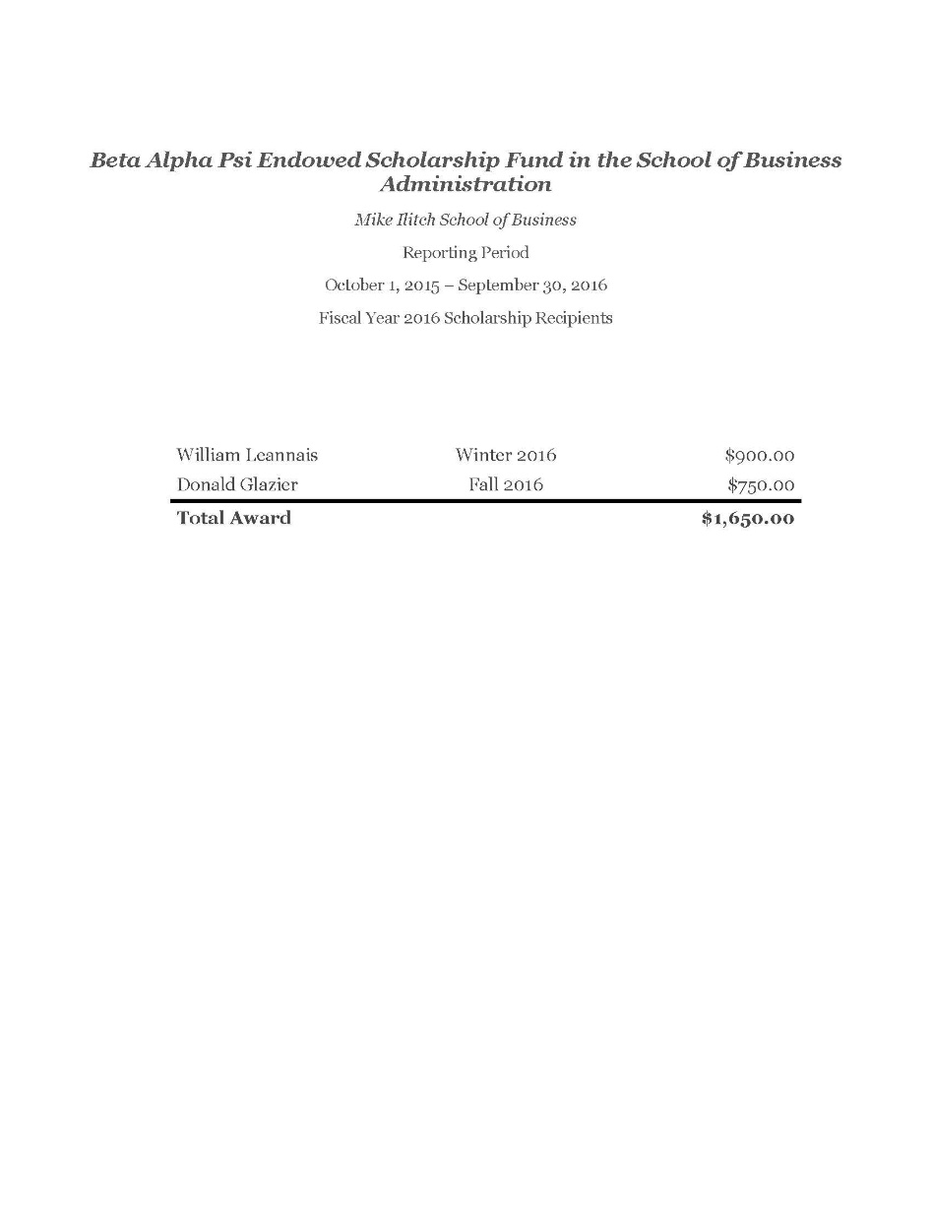

Slide 28
Get your house in order…
Strategic Plan
Gift Acceptance Policy
Recognition Guidelines
Document all your processes
Leave it better then you found it!
Notes:
Mention that you are happy to share our strategic plan structure and how we planned it.

Slide 29
Take the time to make a strategy!
Proactive vs. Reactive
Mission, Vision and Values Statement
Mission: The mission of the Office of Donor Relations is to sustain and nurture lifelong relationships with the university's donors through cultivation, celebration and engagement. We aim to protect the integrity of our donors’ commitment with meaningful stewardship in collaboration with the Wayne State community.
Vision: For donors at all levels of engagement to feel the impact of their support by fostering a university-wide culture of philanthropy.
Strategic Plan and Tactical Action Items
Notes:
Mention that you are happy to share our strategic plan structure and how we planned it.

Slide 30
Find your partners
Steward your colleagues
Have a lot of coffee and lunches
Figure out all the ways your work can support all frontline fundraising activities

Slide 31
Look for ROI…or the lack thereof…
Trim off the fat!
Track your success
Prove the value of your program
Figure out your key performance indicators
Retention, upgrade, attendance and how what Donor Relations does effects fund raising!

Slide 32
Questions?
Leslie Carmona, CFRE
Leslie.Carmona@wayne.edu
313-577-8085

