Slide 1
Involving Students in the Work of Stewardship, Alumni Engagement, and Crowdfunding
Courtney Downey
Former: Director of Alumni, Donor, and Public Relations, Purdue Bands & Orchestras
Current: Assistant Director of Development and Major Gift Operations, Purdue Athletics
July 20, 2017

Slide 2
Student advancement team
Develop Volunteer Student Team
  Gain support of colleagues, so they can help promote the opportunity in class.
  Host call-out events with free food to gauge interest of students.
Organizational Structure
  Use a business model to structure Student Advancement Team.
  Assign your Team Leader (CEO) based on an application process, and have your Team Leader assign Committee Project Leaders (Vice President’s) based on call-out events.
  Make sure students log volunteer hours for resume purposes. Provide benefits at different levels of volunteer hours for students.

Slide 3
Student advancement team
Team Committees
  Think about specific projects the Student Advancement Team can take off your plate and/or add their special touch to.
Develop Strategy
  Host weekly meetings with Team Leader, suggest Team Leader host bi-weekly meetings with Committee Project Leaders, and monthly meetings with entire Student Advancement Team. Communication will be key to the success of this group.

Slide 4
Student advancement team committee Ideas
Stewardship
  Postcards
    Birthday, First-Time Donors
  Year- End Thank You Video
  Thank-A-Thon
Alumni Engagement
  Regional Events
  Alumni Events on Campus
  Publications
  Distinguished Alumni Awards
  Advisory Board Student Panel

Slide 5
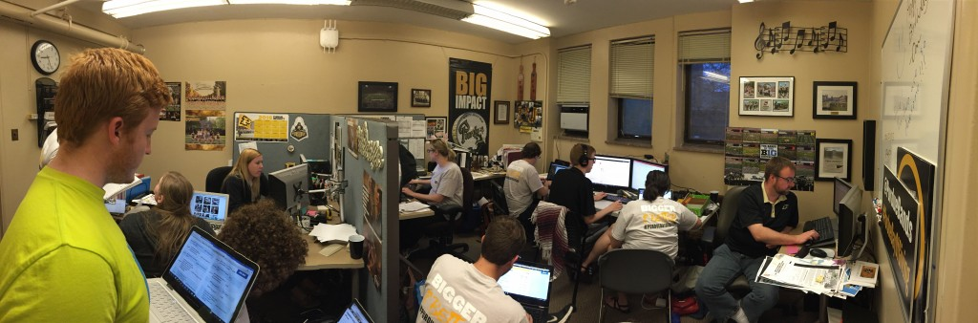
Student advancement team committees
Crowdfunding
  Purdue Day of Giving
  Project Boiler

Slide 6

Stewardship: Birthday Card

Slide 7
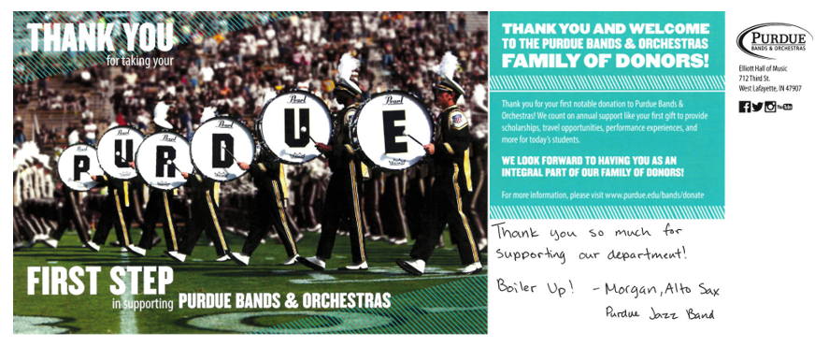
Stewardship: First-Time Donor

Slide 8

Stewardship: Year-End Video
https://www.youtube.com/watch?v=1mttUnjFmEo&feature=youtu.beideo

Slide 9
Stewardship: Thank-A-Thon
Thank-A-Thon
  Allow Student Advancement Team the opportunity to lead a thank-a-thon where all students in department are involved in the thank you process.
  All students write handwritten notes in class while the Student Advancement Team explains why they are doing it. It teaches current students the fundraising cycle and why it is so important also.
  The Student Advancement Team will then proof all notes and addresses all envelopes.

Slide 10
alumni engagement
Regional Events
  Host an event in an area that has a large alumni and donor population.
  Take Student Advancement Team students as representatives.
  Have the Student Advancement Team run registration, mingle with the crowd, set up decorations, and more.

Slide 11
alumni engagement
Alumni Events on Campus
  Host an alumni reunion on campus.
  Have Student Advancement Team run registration, mingle with the crowd at reception, set up decorations, host major donor prospects, and more.

Slide 12
alumni engagement
Publications
  Send hard-copy publications to engage your alumni base.
  In the publication feature three to four students who are involved in the department.
  Alumni love reading about what students are currently doing in an area they are passionate about.

Slide 13
alumni engagement
Distinguished Alumni Awards
  Vote as a team on alumni award winners.
  Allow the Student Advancement Team to co-host alumni while back on campus.
  Have students sit with the alumni at the reception, grab coffee after, help pass out awards at reception, and more.

Slide 14
alumni engagement
Advisory Board Student Panel
  Have students apply for a position on your volunteer board.
  Select 3-4 students for a two-year term.
  Students are responsible for key objectives discussed in meetings, speaking with alumni and donors on conference calls between meetings, writing meeting minutes, and more.

Slide 15
Crowdfunding
Purdue Day of Giving
  Have Student Advancement Team engage all students in the department well in advance.
  Host campaign kick-off meeting to allow students the opportunity to provide their ideas on how to be successful on the day.
  Allow Student Advancement Team the creativity to create marketing content. Encourage your student team to engage their fellow students– peer to peer fundraising!

Slide 16
Crowdfunding
Purdue Day of Giving Cont’d
  Have students be ambassadors in class and help promote via e-mail, social media, posters, text message alerts, e-mails, and more.
  Engage students early and allow them to take ownership of the day.
  Create student-led stewardship team to live thank.

Slide 17
Crowdfunding
Project Boiler (28-day campaign)
  Select a project that is a top fundraising priority for your department.
  Create a marketing plan to reach your fundraising goal with the help of the Student Advancement Team.
  Promote the fundraising campaign on social media, e-mail, and your Student Advancement Team network.
  Solicit Student Advancement Team to provide video content for campaign updates throughout the 28-day campaign.
  Ask for Student Advancement Team’s help in generating stewardship content specific to this campaign as well once completed.

Slide 18
Questions?
cndowney@prf.org
765-494-3424

