Slide 1
New Perspectives View virtual stewardship examples from two or more schools before open discussion with all participants.
Breakout 3 – Donor Relations
Thursday, July 30, 2020
Janie Harmon
Senior Director of Advancement
Julie Byczynski
Director of Advancement
HarmonJ@missouri.edu
jbyczyns@uoguelph.ca

Slide 2
SESSION AGENDA
A ROUNDTABLE DISCUSSION:
New Perspectives on Stewardship
Introductions and House Rules
Two case studies
a. Named Space Unveiling on Instagram - Guelph
b. Virtual $1M Gift Announcement – Missouri
Your stories and questions

Slide 3
Introductions & House Rules Janie
Thank you
“If you had asked me about virtual recognition a year ago….”
Participation from all schools
Yes, we can be successful virtually

Slide 4
Case Study #1 University of Guelph, Ontario Veterinary College Julie
Virtual Named Space Unveiling
New surgical suite named for James, the dog
Pre-COVID, but applicable to today’s reality
Donor is active on Instagram
We needed CONTENT

Slide 5
Case Study #1 University of Guelph Julie
Named Space Unveiling on Instagram
More views, farther reach than traditional
Different logistics than a typical event – not necessarily less work!
Lasting impact
Portrait inspires other donors

Slide 6
Case Study #2 University of Missouri Janie
Virtual $1M Gift Announcement
Background
Strategy
Challenges of virtual announcement
Video and virtual news conference
Donor perspective
Lessons learned

Slide 7
Case Study #2 University of Missouri Janie

Slide 8
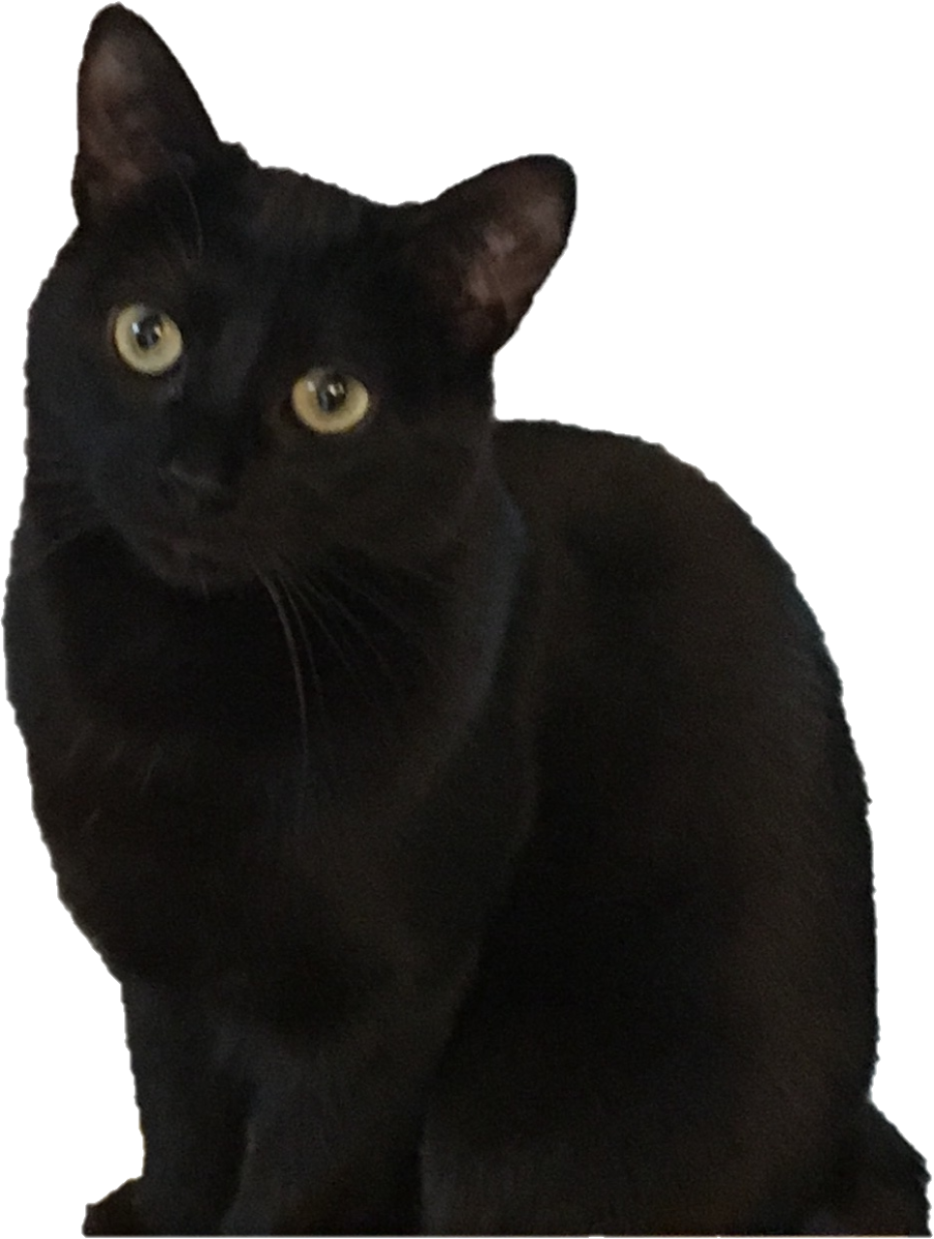
Your Stories and Questions Julie/ALL
What have you done different to steward donors during the pandemic?
How are you replacing donor hospital tours, which have so much impact?
What works well?
What would you do differently next time to make even better?

Slide 9
Additional Stories
This year your gift supports immediate classroom remodel needs as the College of Veterinary Medicine prepares for the AVMA COE accreditation site visit. As we prepare for the announcement of your gift tomorrow, Emily Lemoine, third year student, has a message for you on behalf of all the students.

Slide 10
Additional Stories
Welcome to the Connaway Society

Slide 11
THANK YOU FOR JOINING OUR DONOR RELATIONS BREAKOUT
Janie Harmon
Senior Director of Advancement
Julie Byczynski
Director of Advancement
HarmonJ@missouri.edu
jbyczyns@uoguelph.ca
Big thank you to our Moderators:
Anila Mehmood Stewardship Coordinator, UC Davis School of Veterinary Medicine
Rachel Thudium, University of Missouri

