Slide 1
How to keep your donor’s head in the game. It’s okay to keep asking for money despite the difficult times, but how do you approach this?
Breakout 4 - Fundraising
Thursday, July 30, 2020
Tracy Evans- LSU
Senior Director of Development
LSU School of Veterinary Medicine, AgCenter & College of Agriculture
Clayton Forbes, LSU
Director of Development
LSU School of Veterinary Medicine, AgCenter & College of Agriculture

Slide 2
Evaluate your relationship before the call or crafting a message.
Determine your “happy medium/compromise”
Two heads are better than one . . . Talk it though with a colleague. We are all in this together.
Be prepared to share the immediate impact and necessity of the gift. How will it drive the mission and vision of the University in light of the current crisis.
Don’t make excuses.

Slide 3
Donor Hypothetical #1
Art Vandelay, President & CEO of Vandelay Industries
Latex Manufacturing Tycoon
Tracy Evans had 20 different contacts with Art over the course of 3 years, which included 8 face-to-face visits, two of which were events Art and his wife Elaine attended at LSU with Tracy as their host.
In asking the passion question early on, Art expressed to Tracy that he was a first-generation college graduate, and his passion is to pay it forward for other first-generation students.
When Tracy had dinner with Art and Elaine over the summer, she asked if they would consider a proposal to support scholarships at LSU for first-generation students. Of course, they said yes.
In November of 2019, Tracy presented Art and Elaine with a $1M proposal to fund a first-generation endowment at LSU. They had plans to meet again in the early spring to discuss the gift further.
COVID-19 hit . . . And you all know the rest
Tracy Evans reached out to Art for a call. He shared that although the Latex industry is booming, his personal investments have taken a hit, but he’s still willing to take a call.

Slide 4
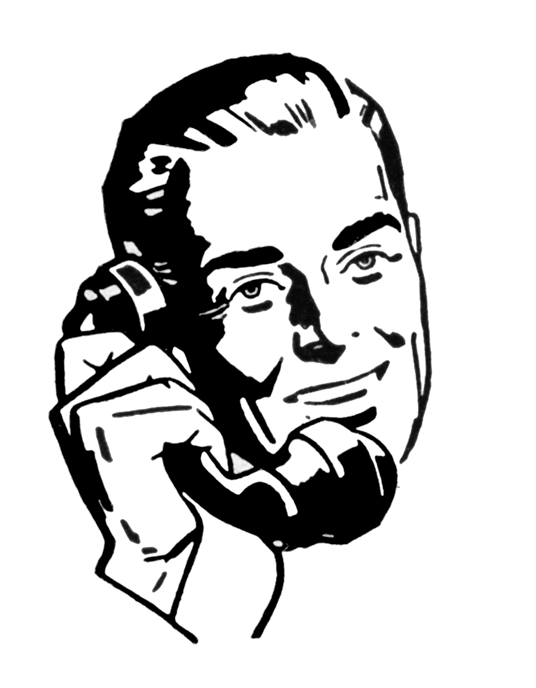
THE CALL
Art: Hi Tracy, how are things at LSU right now?
Wow, Tracy, it sounds like LSU is really making a difference.
Well, as I mentioned in my email, my business is doing well, but my personal investments took a hit. I don’t think that Elaine and I are in a position to fund a $1M endowment for the time being.
Tracy: Gives Art an update on all the cool things LSU is doing to support the fight of COVID-19
Thank you for taking my call. I appreciate you sharing your current situation regarding the proposal that I submitted to you and Elaine last year.
I understand, Art, I’m sure this is difficult for you
to share. I really felt your passion about supporting first-
generation students when we had dinner in the fall. With the hardships that our students are currently experiencing, scholarship support has never been more important. Would you consider funding the spending account of the scholarship at $40,000 annually with the option to establish the endowment when your investments have recovered?
Notes:
Benefit to Situation is that 1. he already told you his position before the call, but 2. he was still willing to take the call. So, this gives you the opportunity to strategize before the call on how to redirect Art to move on something. This is where evaluating your relationship before the call and knowing where you stand with your compromise is important.

Slide 5
Real Donor #2
John Smith
Grateful Client of the LSU SVM
Tracy Evans knew John through a family friend. He reached out in 2018 to let share that his dog had been euthanized in the hospital and he was leaving on a 2-week vacation; could I retrieve his ashes for him while he was out of town?
We met when he returned, shared pleasantries and parted ways. To show his appreciation for the care he received, he sent a $500 check to support the Cardiology Department in the VTH. We stayed in touch periodically by text message and email just to check-in.
At the end of 2018 we started emailing about exploring ways to support the Vet School on a broader level. We discussed several options by phone, but didn’t have a chance to actually meet about them until early 2019. When we met, he initially only wanted to give $5,000 to support the Cardiology Department, but I shared with him the option of a blended planned gift to establish an endowment for the department with cash gifts to fund the spending allocation. I was selling the “concept” of perpetuity. Then COVID-19 hit.
I presented him with a proposal of $85,000, a $60,000 estate gift with a $25,000 cash gift to fund the spending allocation. He was still considering a pledge, but he became concerned about his salary and wanted flexibility in his payments. He was also concerned about being able to meet with his attorney and wasn’t sure how to handle the estate portion of the gift.

Slide 6
Options
John shared further that he fully intends to pay the $25,000 in five years, but he wanted the flexibility to adjust his annual payments based on the fluctuation in his salary.
With the guidance of the LSU Foundation legal counsel, I was able to present John with the following options.
Instead of putting specific annual dollar increments for pledge payments, we put a start date of 2020 and an end date of 2024. This way he pays in 5 years, but he’s not obligated to a specific amount each year.
The legal counsel recommended that we establish the gift agreement and put an endowment conversation clause for whenever he is ready to move forward with the estate part of the gift.
Notes:
Important things to note in keeping your donor’s head in the game. Be flexible with the current situation. Partner with experts in your administration that can help you think outside the box with solutions to your donor’s issues. As always, continue to steward your donor in a way that shows the immediate impact of their gift.

Slide 7
How to Keep Gift Conversation Going
1: Pause – Listen, really hear what they are saying so that you are in a good position to guide alternatives if necessary.
2: Practical – Based on response, compromise or determine a happy medium. Restate their passion and our impact.
3: Patient – Advise and redirect the conversation as needed, speak from the heart and answer any questions that arise.
4: Persistence & Prepared –Advise and redirect the conversation, speak from the heart and answer all questions that arise honestly and truthfully. Talk about how COVID 19 did not deter our focus.

Slide 8
Real Donor #3
Mr. Ron Swanson
LSU DVM
LSU DVM 1985
Visited in Arkansas in November 2019
Submitted $1.2 M endowed full-ride scholarship proposal
No children; Takes care of mom
Ron revealed in March he was ready to pull trigger on closing gift but…
COVID 19 strikes
______________________________
Post COVID conversations with Donor
In late June he lets me know he is ready to finalize his will.
How to determine a happy medium? Be Practical.
Notes:
Ron: Hi Clayton, how are things at LSU right now?
Clayton: Hi Ron, thank you for taking my call. I appreciate you sharing your current situation regarding the proposal that I submitted to you earlier this year. There are really cool things LSU is doing to support the fight of COVID-19. One is making sure to help find recruiting scholarships for our SVM students to secure the best and the brightest.
Ron: Terrific! It sounds like LSU is really focused on making an immediate impact. That makes me feel good as that is where I was leaning before COVID. As I mentioned in my email, my mom is my first priority. I want to finalize my will now and make certain to be able and take care of myself and help the LSU SVM.
Clayton: (Happy Medium Compromise) Absolutely! We understand, and we want to make sure you and your mom are taken care of first so we can still achieve what you want to do for LSU SVM.
I really felt your passion about helping veterinary
students with a full-ride scholarship when we had breakfast earlier this year. Would you consider a companion gift to partially fund the spending account of the scholarship at $40,000 annually now?

Slide 9
THE CALL
Ron: Hi Clayton, how are things at LSU right now?
Clayton: Hi Ron, thank you for taking my call. I appreciate you sharing your current situation regarding the proposal that I submitted to you earlier this year. There are really cool things LSU is doing to support the fight of COVID-19. One is making sure to help find recruiting scholarships for our SVM students to secure the best and the brightest.
Ron: Terrific! It sounds like LSU is really focused on making an immediate impact. That makes me feel good as that is where I was leaning before COVID. As I mentioned in my email, my mom is my first priority. I want to finalize my will now and make certain to be able and take care of myself and help the LSU SVM.
Clayton: (Happy Medium Compromise) Absolutely! We understand, and we want to make sure you and your mom are taken care of first so we can still achieve what you want to do for LSU SVM.
I really felt your passion about helping veterinary
students with a full-ride scholarship when we had breakfast earlier this year. Would you consider a companion gift to partially fund the spending account of the scholarship at $40,000 annually now?

Slide 10
Real Donor #4
Mr. Ben Wyatt & Mrs. Leslie Knope
LSU DVM
LSU DVM 1983
1st visited in Vermont in February 2019
Submitted $125K endowed scholarship proposal
3 grown children – still supporting
COVID 19 strikes
______________________________
Post COVID conversations with Donor
Ben originally asks to hold discussion until May 2020
In May he lets me know he is set to retire in June and asked to delay discussion until August 2020
What to do? Be Patient.
Notes:
Be Patient. He let me know he still wants to do a scholarship. He just needs to adjust his timeline now due to retirement and figuring out his level of giving.
Acknowledge our need but let him know we would be happy to wait.
Clarify when – would August work?
Discuss how important and impactful these gifts are now for 1st year students.
Spending Account? Find out if he would be willing to do a cash gift now to support this scholarship. Gives an opportunity to come back later if he is happy and properly stewarded.

Slide 11
Real Donor #5
Ms. Donna Meagle
LSU DVM
LSU DVM 1991
Visited in New Orleans in February 2020
Submitted $1.8 M endowed full-ride scholarship proposal
No children
Donna originally discussed closing by March 2020 but…
COVID 19 strikes
______________________________
Post COVID conversations with Donor
Now Donna’s advisers say due to stock markets projections for a full-ride scholarship are off the table
Now all accounts solidified and is determining what she can do now.
How to best redirect conversation? Be persistent and prepared.
Notes:
Be Persistent, passionate and prepared: Donna wants to help with a full-ride scholarship. Right now that might not be possible.
Size gifts to give options? Waiting for clarification on amounts from advisers. Remind her of our needs for cash gifts now and how fun it would be for her to award this year.
Share passion for how this will make a big impact on student debt.
Be prepared to answer any questions, do my homework before the call, and be okay to say great question. Now it is just a good reason to circle back with you to share an answer.

Slide 12
Donor Input
They want to focus on more impactful short-term smaller gifts.
They want flexibility in their payment plans
Highlight the positive about LSU and what their gift can do
Be prepared to explain the urgency if there is one
Options to change and add to gifts later
Be grateful for an annual leadership gift knowing that more will come when markets recover
Sometimes donors are not going to be as forthcoming with their situation, so be an active listener and look for signs
Be patient. We still love LSU, but may need to defer our giving to a better time. Keep the relationship alive.

Slide 13
Inspiration from our Senior DO’s
"We are confronting this challenging situation of the COVID-19 pandemic in the way that you would expect – by continuing with great work in the classroom and beyond, although remotely for now. Understanding that everyone’s individual situation is evolving, your valued partnership is essential for our success and will help us to be even stronger on the other side of this health crisis. Please accept my sincere appreciation for considering your continued philanthropy and staying connected to the (College of Science, Manship, A&D) at this time.” --- Eric Guerin, Senior Director of Development Oak Cohort

Slide 14
Inspiration from our Senior DO’s
“We know that this is an unprecedented time and want to be sure to be sensitive to all that it entails. Based on some of our previous conversations, I wanted to check in to see how are you thinking about your philanthropy at this time.” --- Lindsey Fussell, Senior Director of Development, College of Business
“While I know we planned to get together this spring to discuss your gift to ____________, I sincerely appreciate how much has changed in a very short amount of time. If this is still something you are considering in the near term, I am available to connect at your convenience. If your timeline has shifted, I completely understand and stand ready to continue the conversation when the time is right for you”. --- Anonymous

Slide 15
Inspiration from our Senior DO’s
“You have always ensured the success of our students, faculty, and programs with your philanthropic support, and the College of Business would not be what it is today without you. An annual gift in support of Dean’s Excellence Fund at this crucial time will go a long way to provide the Dean with unrestricted support needed to meet the college’s greatest needs. With a single gift, you will reach students and faculty while ensuring the college is a leader in research and economic development”. --- Anonymous

Slide 16
Questions/Comments?

