Slide 1
Student Support at
College of Veterinary Medicine

Slide 2
Iowa State University
College of Veterinary Medicine Development Team
Amy Kruzich Executive Director
Trent Wellman Director of Development
Deb Calderwood Director of Development
Bev Huisman Development Coordinator

Slide 3
Agenda
Overview of Student Support at ISU (Amy)
Diversity, Equity, and Inclusion Scholarships at ISU (Deb)
Donor Communication and Acknowledgement (Trent)
Scholarship Recognition Program and Donor Reception (Bev and Amy)
Dean Grooms’ Challenge for 2023 (Trent)

Slide 4
Student Support at the College of Veterinary Medicine
Amy Kruzich

Slide 5
Scholarship Fundraising Strategies at ISU
Historical
Campaign Forever True
Future
Often given through the college instead of the foundation.
Small amounts for as many students as possible.
Typically not a Dean’s top priority.
Awards given at private ceremony with the college community.
Targeted messaging on scholarship support as a top Dean’s priority.
Focus on larger/higher impact scholarships.
Focus on donor acknowledgment.
Public ceremony and donor reception promoting philanthropy.
Focus on DEI scholarships.
Dean Grooms’ 2023 Challenge: Double scholarship funds expended annually.
Building capacity for stewardship.

Slide 6
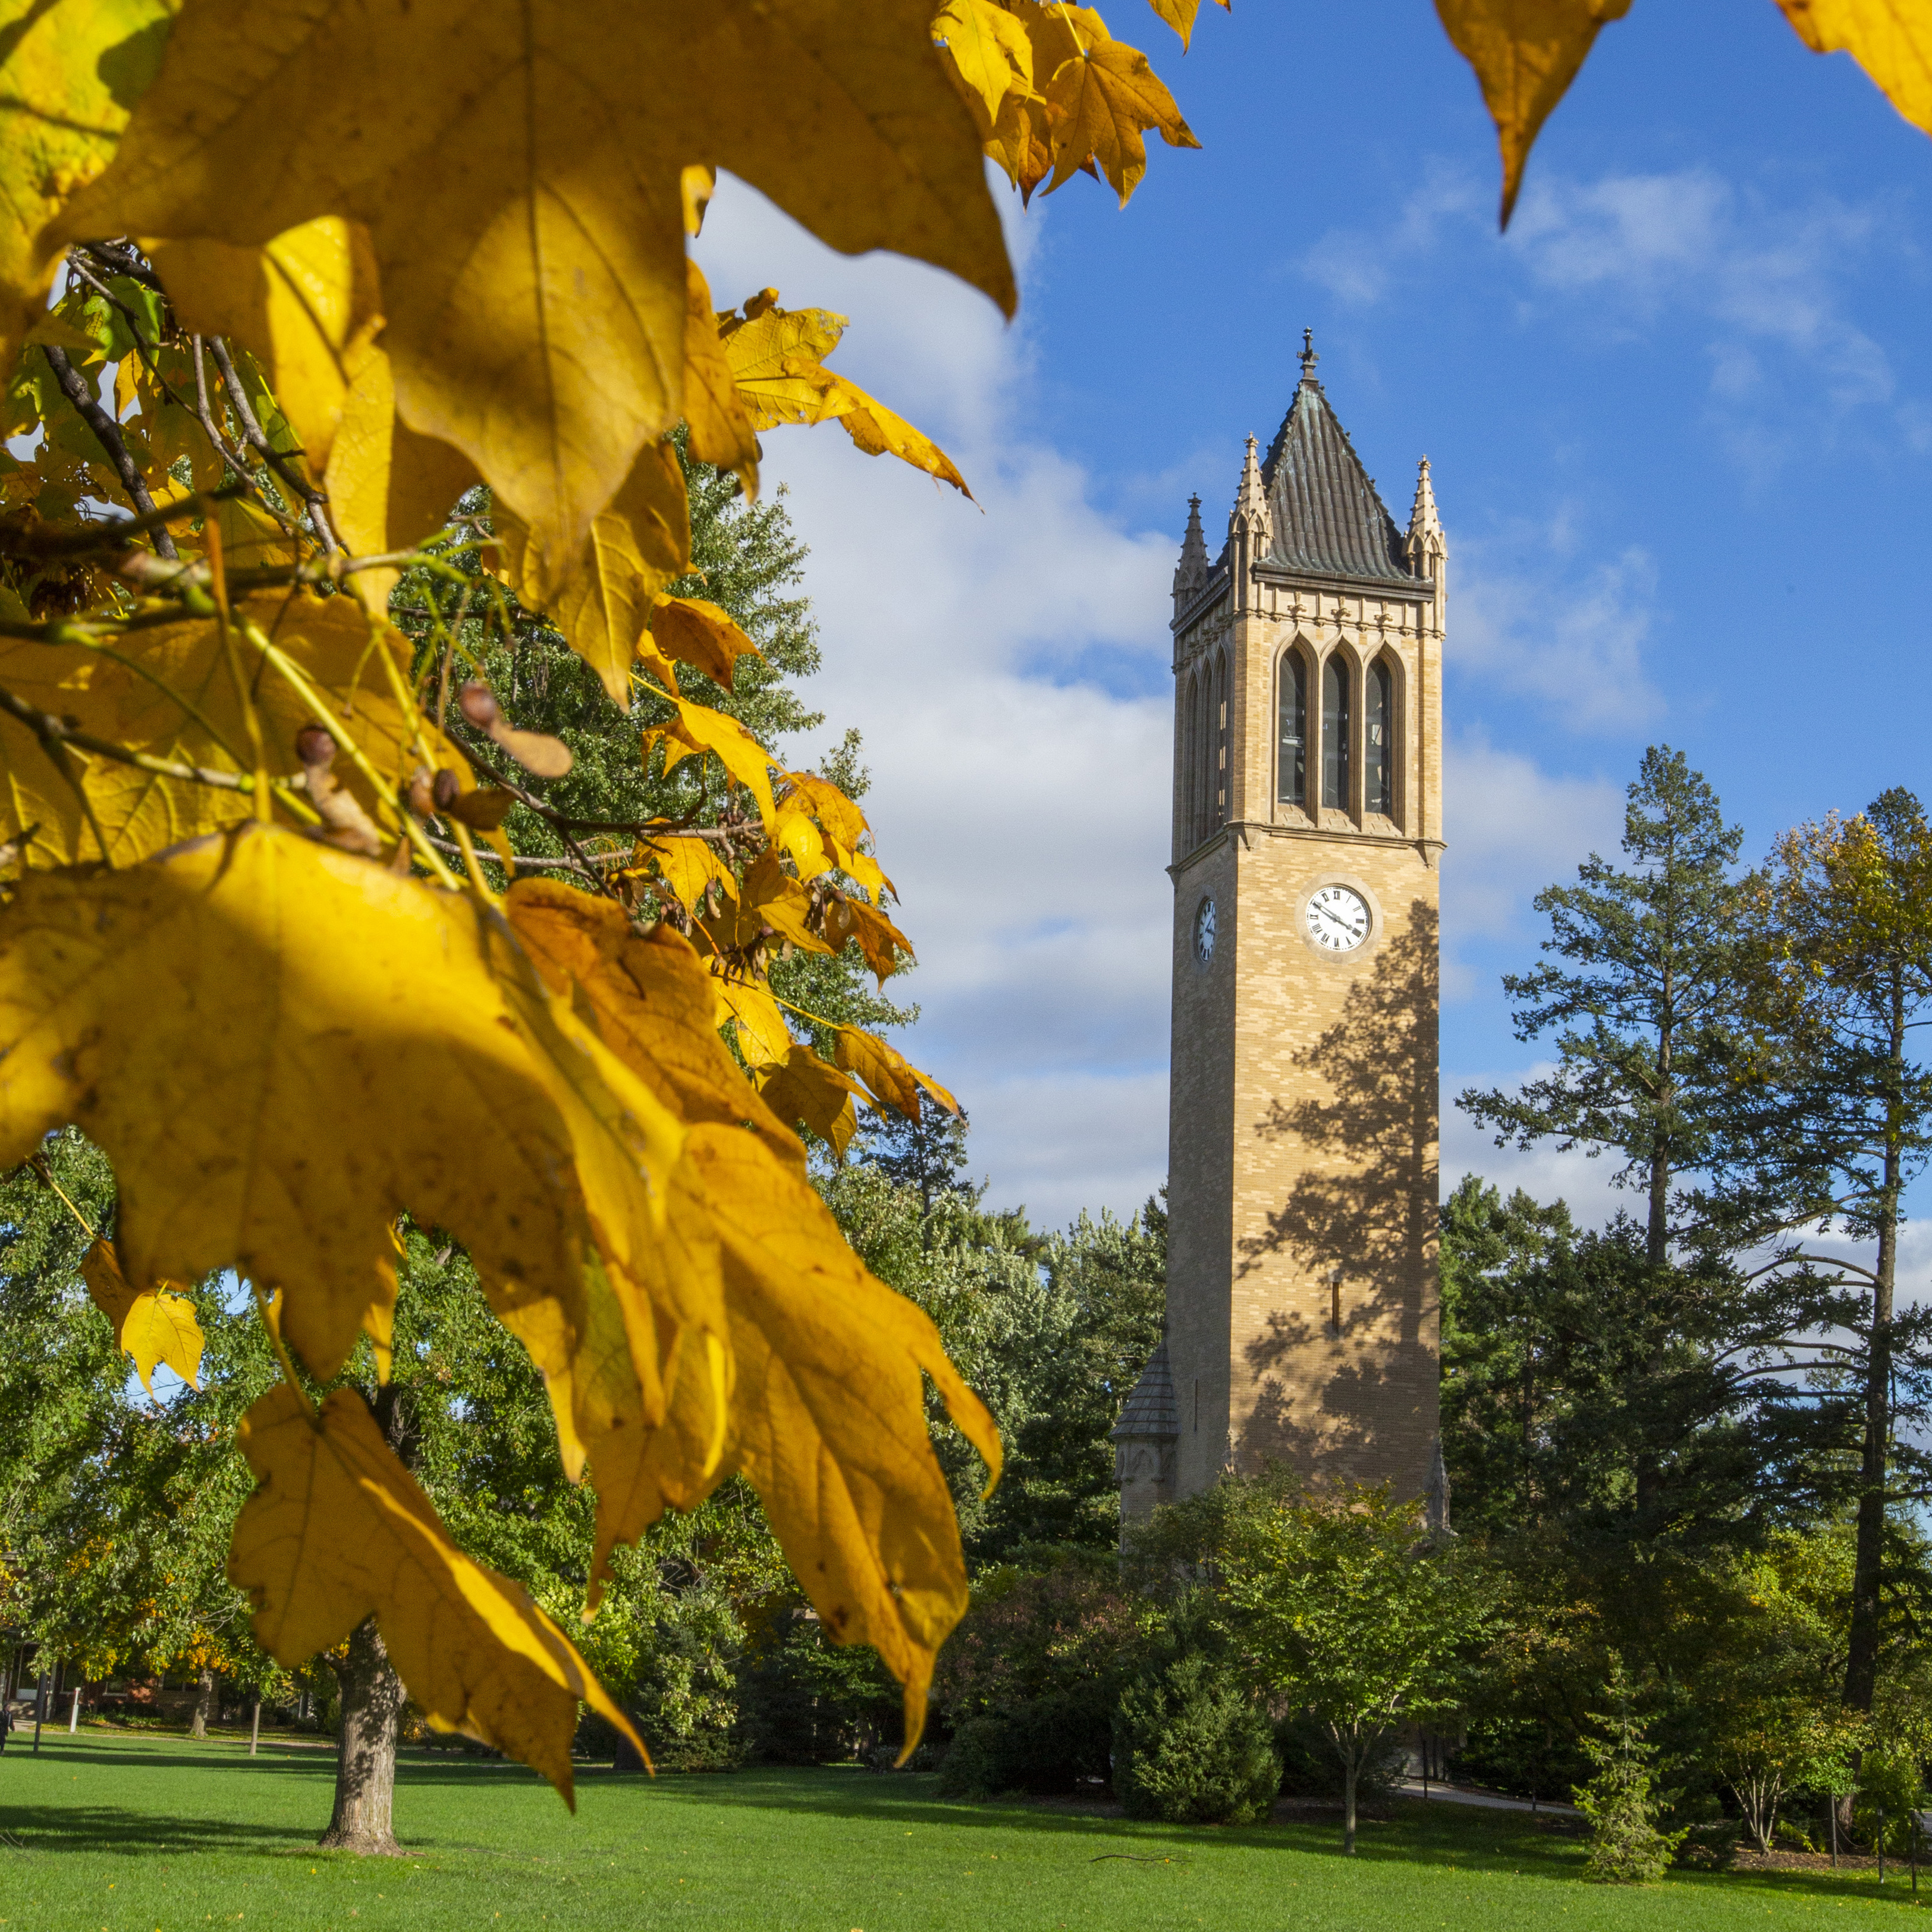
Scholarship Impact of Campaign Forever True at the CVM

Slide 7
Campaign Forever True Scholarship Giving
Awarded on average, $338,000 per year before increased emphasis on scholarship donations
150 of scholarships awarded in 2012
$11.9 million of our $82.1 million campaign total to date
63 newly established scholarships during campaign
Over $1.1 million awarded in the fall of 2019
276 scholarships awarded in 2019

Slide 8
Diversity, Equity & Inclusion
Scholarships
Deb Calderwood, Director of Development
Iowa State University

Slide 9
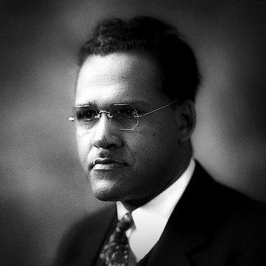
Frederick Douglass Patterson DVM ‘23
Frederick Douglass Patterson Diversity and Inclusion Award
Frederick Douglass Patterson Diversity and Inclusion Scholarship
Notes:
The Frederick Douglass Patterson Scholarship was created to honor the personal merits and attributes of Patterson, who served as president of the Tuskegee Institute and is the founder of the United Negro College Fund. Scholarships will be awarded to current and incoming DVM students.
This D & I award recognizes CVM faculty and P&S staff who have advanced the college's mission of diversity, equity and inclusion through involvement in college initiatives and an indication of continuing commitment to these areas.

Slide 10
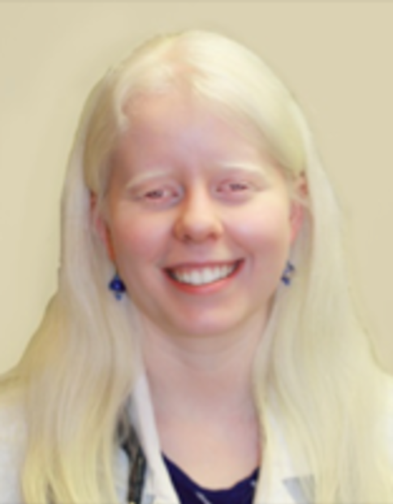
Sydney LaRue DVM ‘16 Scholarship
Students with Albinism or
documented disability
Notes:
Recipients shall have a documented disability and have established eligibility with the Office of Student Disabilities. Recipients shall be students with albinism. If there are no students with albinism students with a documented disability may be selected. In the event there are no students with a documented disability, students who are active in wet labs and/or student organizations may be selected as determined by the administering authority.

Slide 11
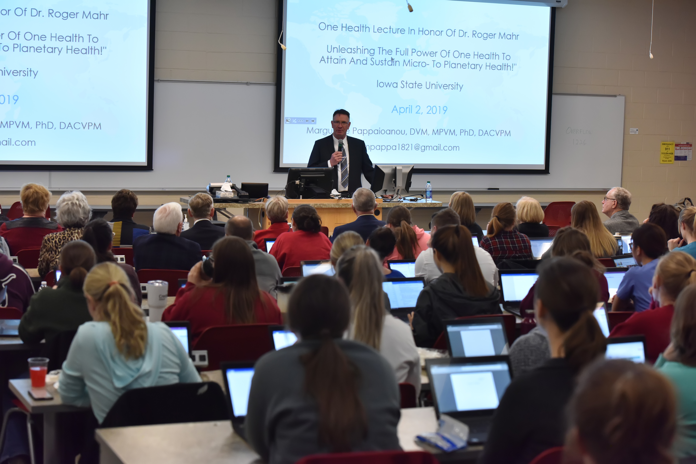
Diversity, Equity & Inclusion
Strategies
Communications
Marketing
Consistent messaging
Notes:
Incorporate the scholarship opportunities in all our publications and communications regularly. Consistent messaging is important to the Dean and our President.

Slide 12
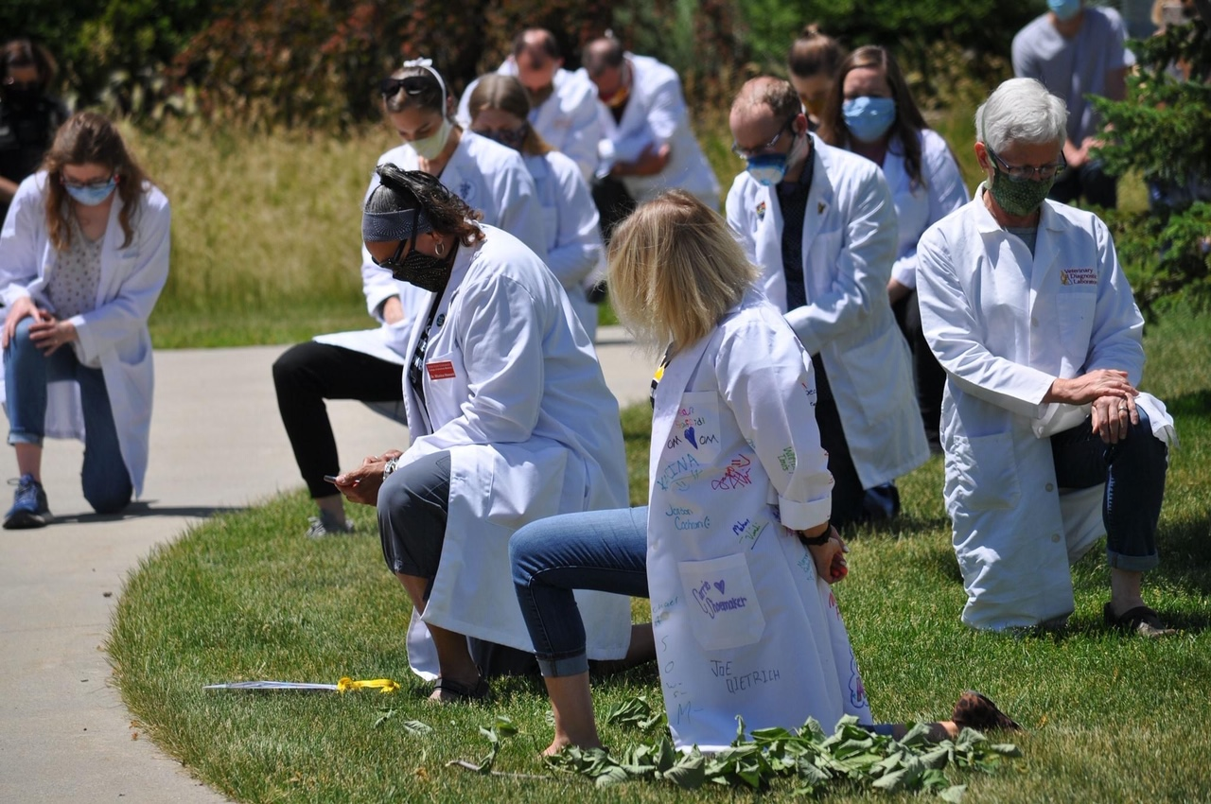
Diversity, Equity & Inclusion
Implementation
White Coats for Black Lives
Purdue Online Certificate
D.E.& I Cohort
Notes:
Many can talk the talk, but we walk the walk at IaState.
As part of the National White Coats for Black Lives Matter event, ISU faculty and students were invited to pause for 8 minutes and 46 seconds to reflect on life of George Floyd.

Slide 13
Scholarship
Acknowledgement Process
Trent Wellman, Director of Development
Iowa State University

Slide 14
Buy In from the Top

Slide 15
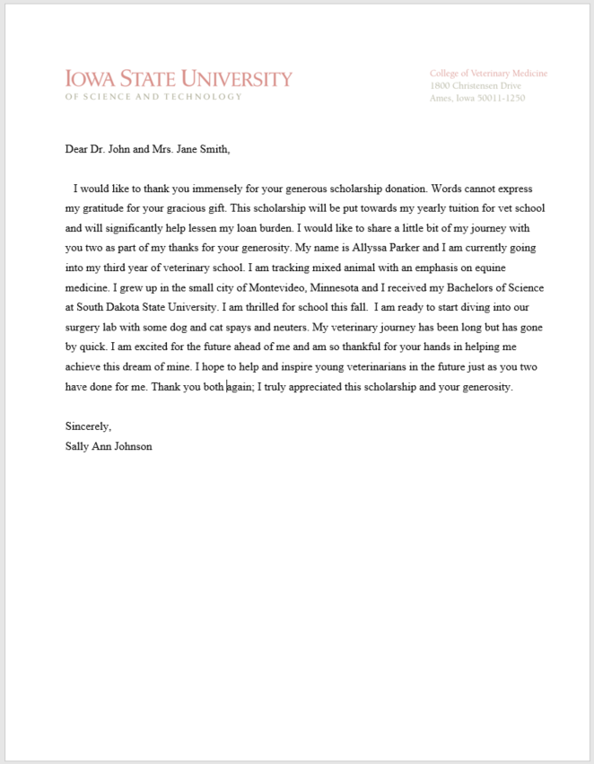

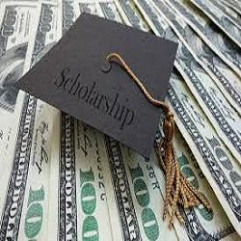
Buy In from the Top
X
X

Slide 16
Standard Operating Procedure
Mid-November 2019 (Before Thanksgiving) – Notify current students that application process is open
FAFSA – December 1 deadline – OASA remind students deadline
January 2, 2020 – Email reminder to students that applications deadline is approaching
January 10, 2020 – Deadline for current students to complete applications
January 13, 2020 – Download applications, create lists for the awards committee
February 1, 2020 - Give list of scholarships and applicants to the awards committee
March 1, 2020 – Scholarship selections due from awards committee
March 1-20, 2020 – Enter scholarship selections into OneApp
April 1, 2020 – Notify scholarship recipients through OneApp
April 15, 2020 – Deadline for students to accept scholarships
By April 15, 2020 – The students have been notified in order to receive their scholarship, they are required to complete a donor thank you
May 1, 2020 – Finalize letter from DEAN for donor thank you
May 1, 2020 – Send second and final reminder for donor thank you
May 15, 2020 – Thank-you notes to donors due by recipients
Mid- June – Send acknowledgment letters and thank you notes to donors

Slide 17
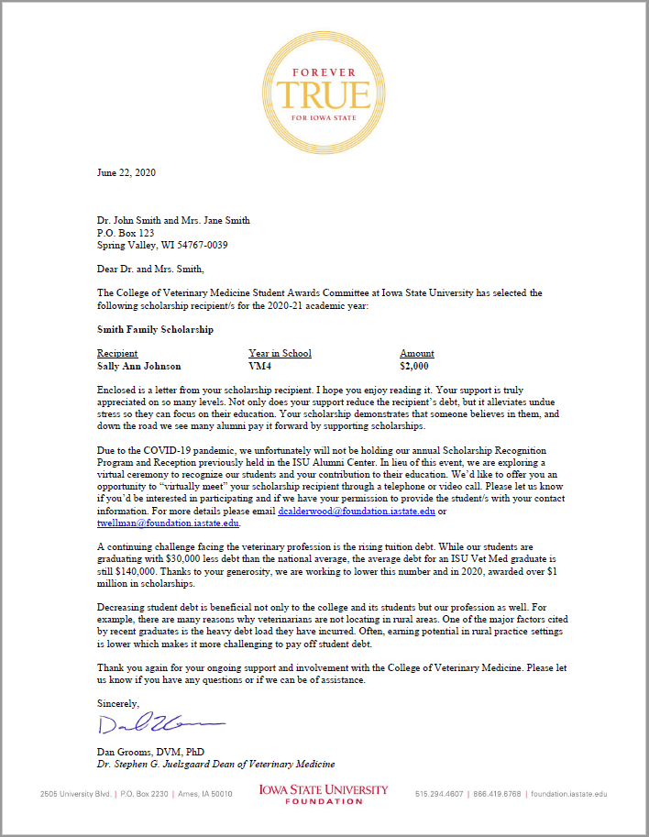
Donor Acknowledgement Letter

Slide 18
Stewarding our Donors:
Annual Scholarship Recognition Program and Donor Reception
Bev Huisman and Amy Kruzich

Slide 19
Scholarship Program
  Attendees - donors, scholarship recipients, family members and faculty/administration
  Awards Booklet - lists all scholarships, donor name, and the recipient
  Short program with speaker to talk about the importance of scholarships
  Presentation of awards – each student announced and Dean hands each recipient a Gentle Doctor pin
Dessert Reception
  Informal dessert reception where donors are given the opportunity to interact with students, family members and faculty/administration

Slide 20
Donor Reception
  Donors are introduced to students
  Photos taken of donor with student
  Reception, food, and awards booklet sponsored by donor couple
End of event
  Donors leave feeling good about their gifts
  Students leave feeling good about their scholarships
  Development staff is exhausted!!

Slide 21
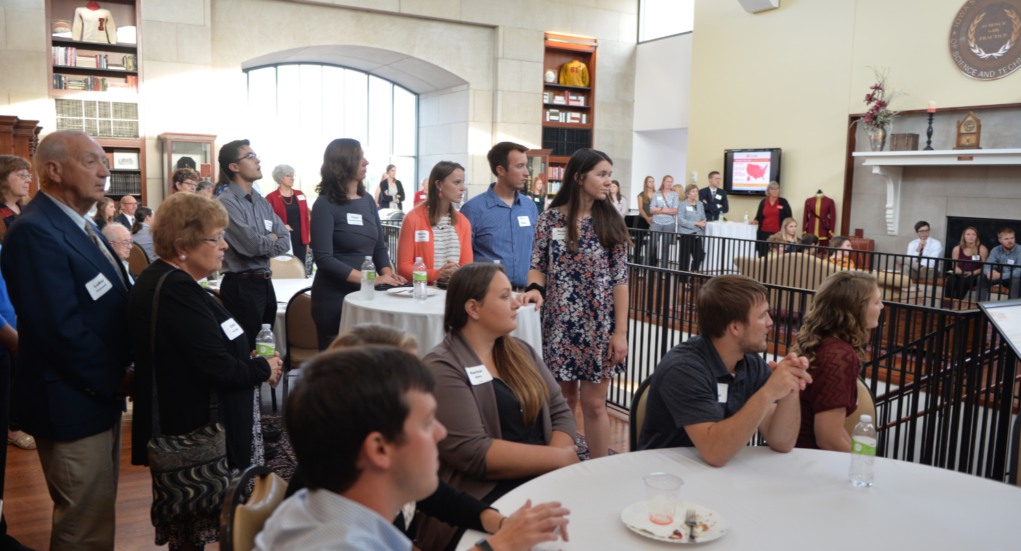

Slide 22
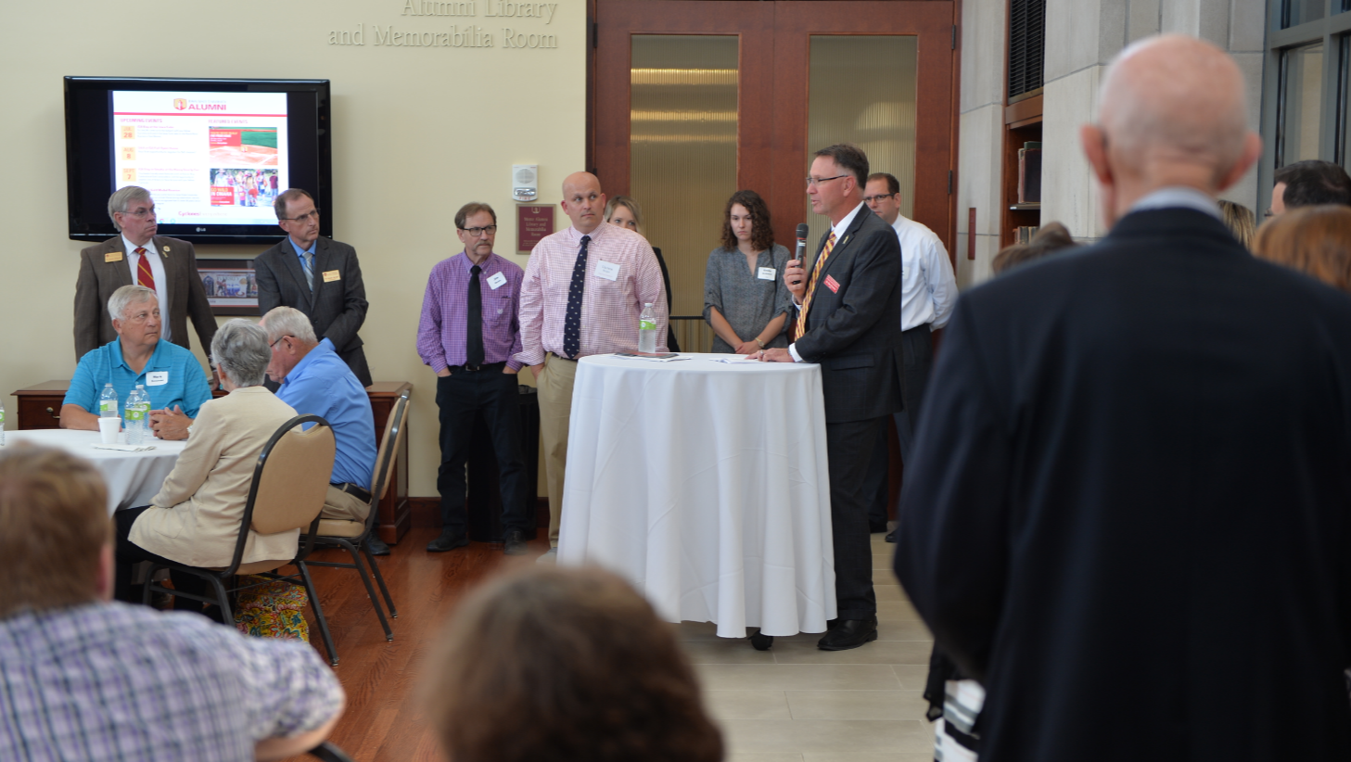

Slide 23
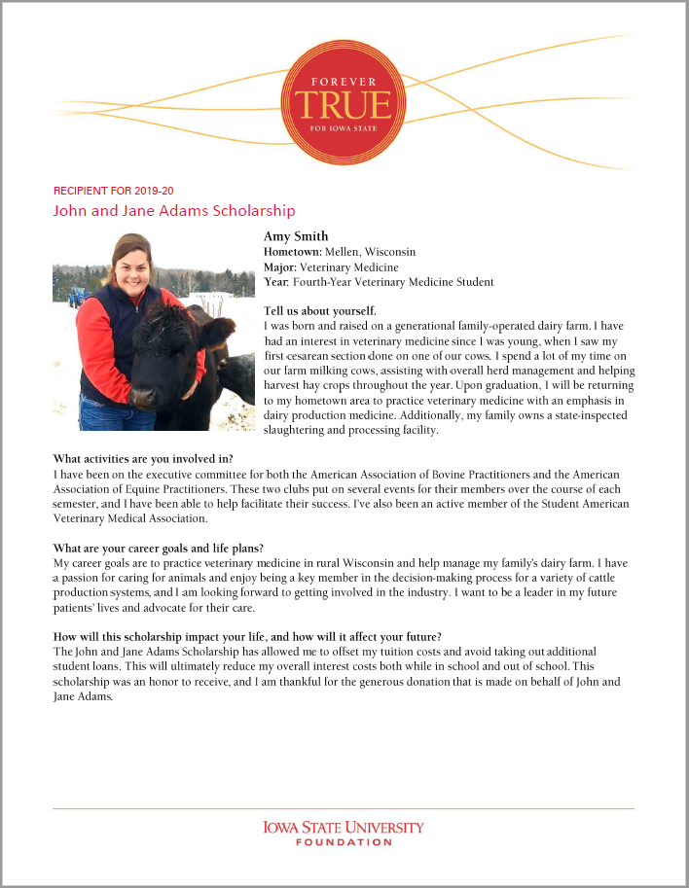

Slide 24
New Challenge
Trent Wellman

Slide 25
our challenge..
Scholarship awards more than
doubled in five years.
Dean Grooms’ goal is to double scholarship awards from
$1 to $2 million by 2023.
Transformational Scholarships

Slide 26
DISCUSSION
Ideas, thoughts, questions?
THANK YOU
Amy Kruzich – akruzich@foundation.iastate.edu
515-520-1621
Bev Huisman – bhuisman@foundation.iastate.edu
515-294-0867
Deb Calderwood – dcalderwood@foundation.iastate.edu
319-929-4337
Trent Wellman – twellman@foundation.iastate.edu
319-316-2504

